Slide 1
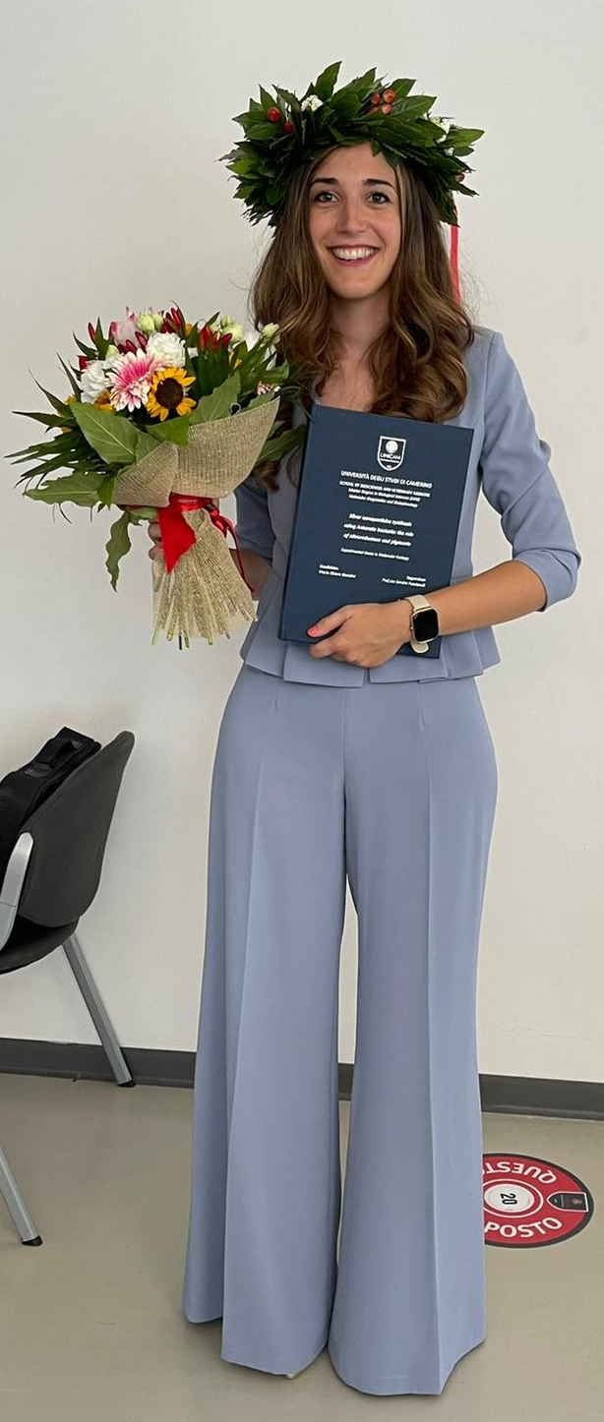
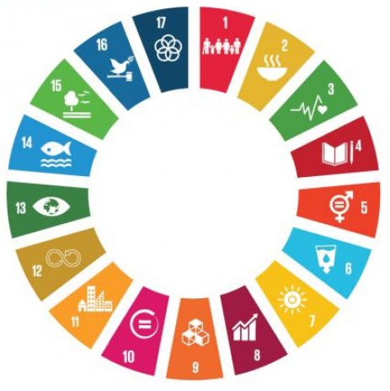

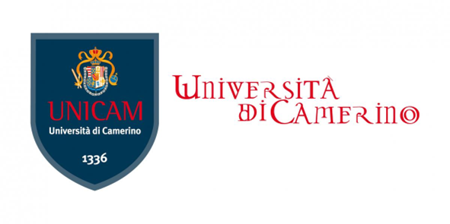
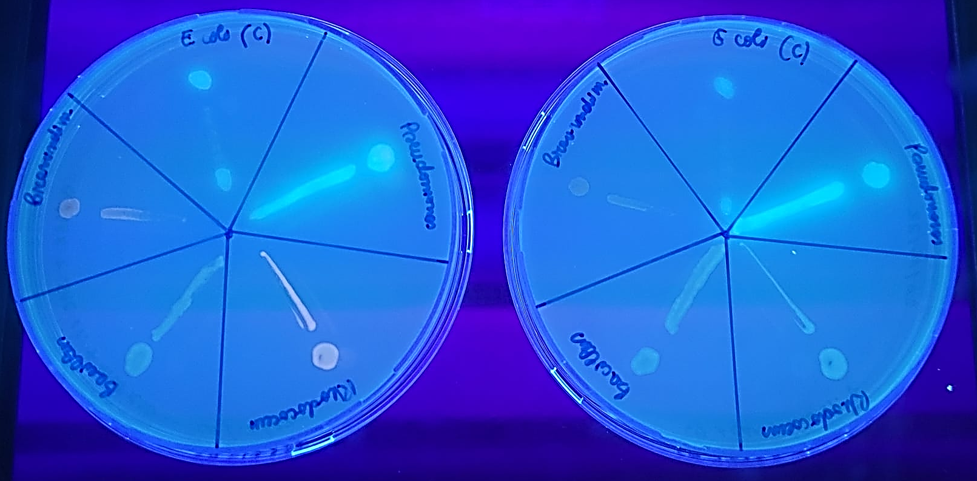
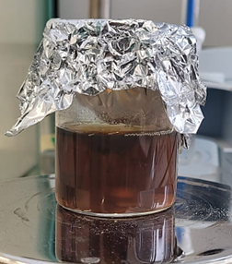
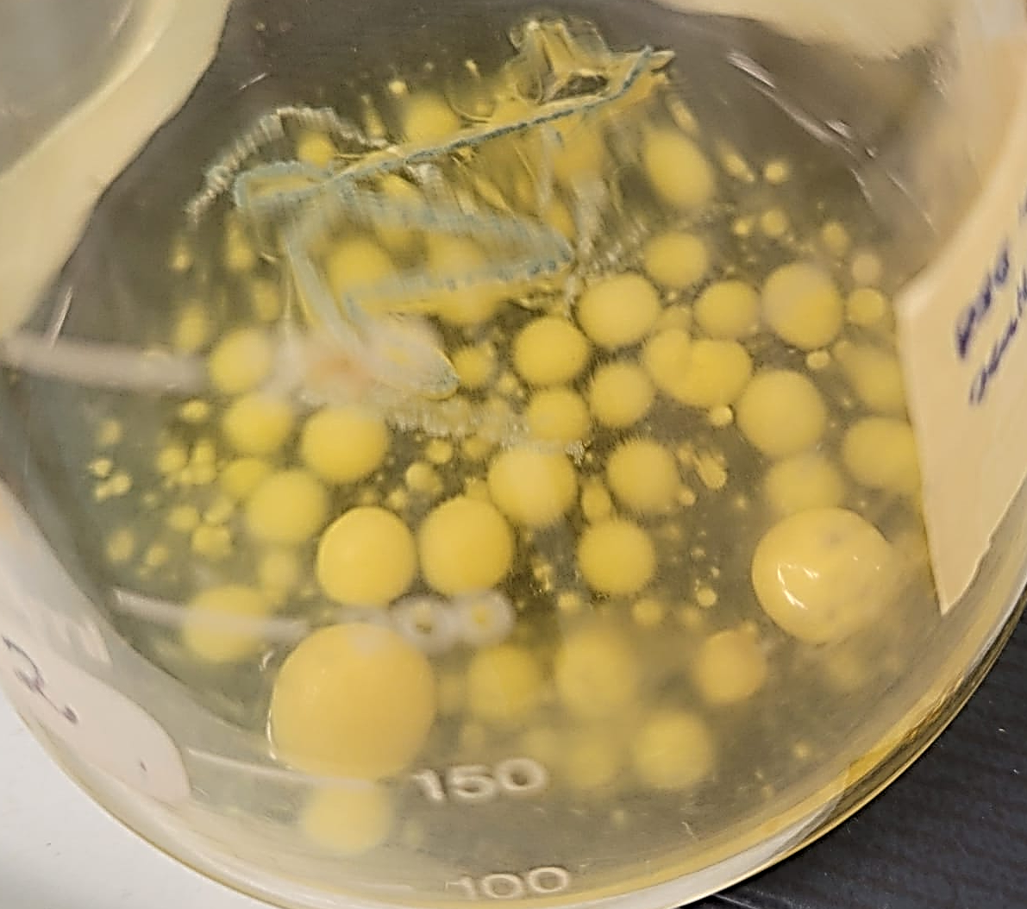
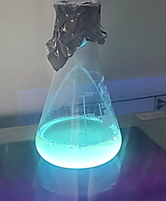
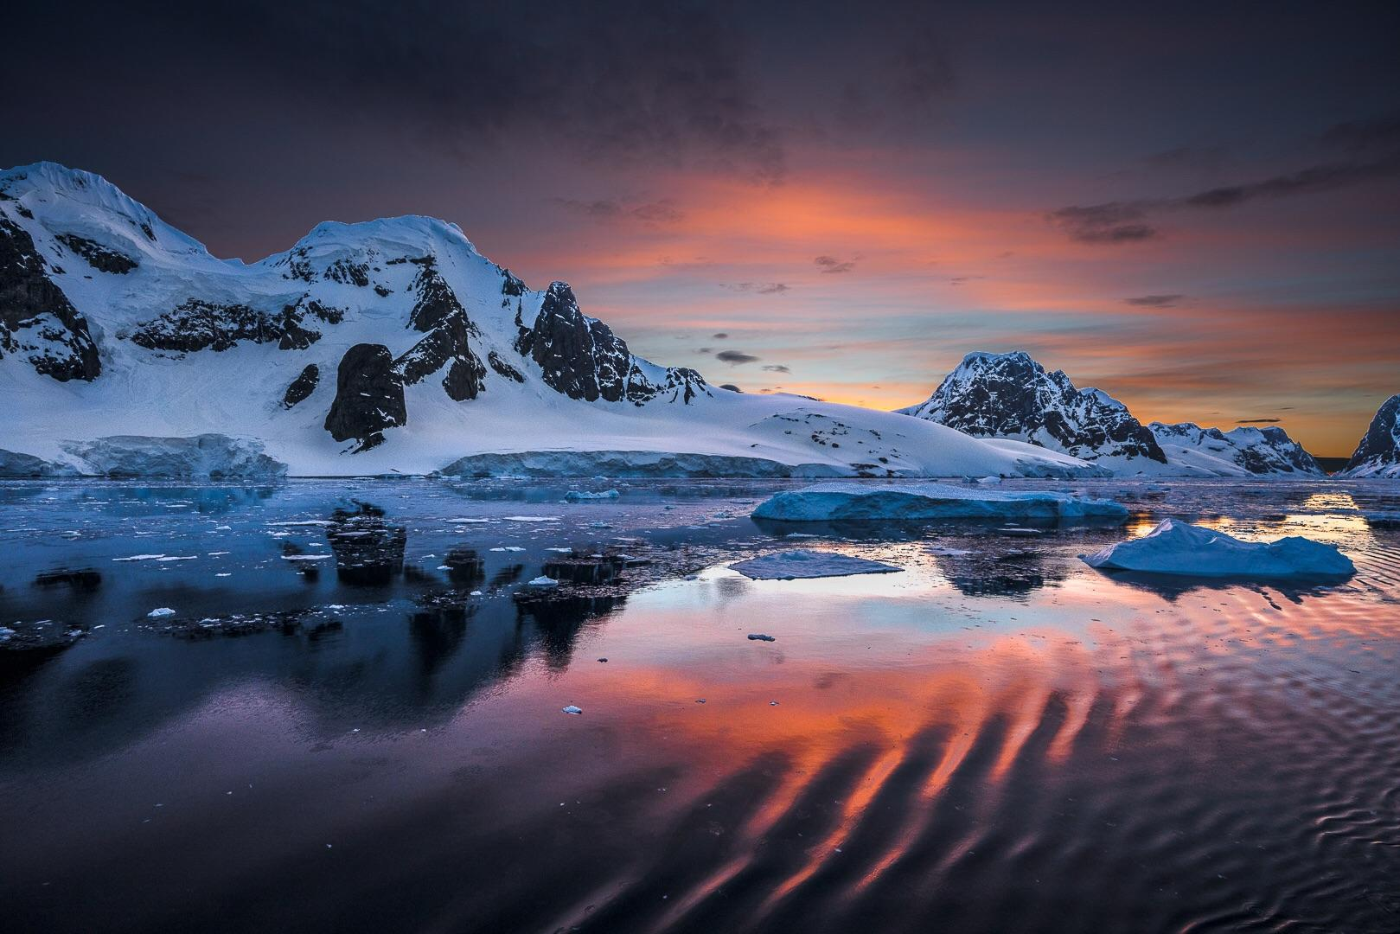
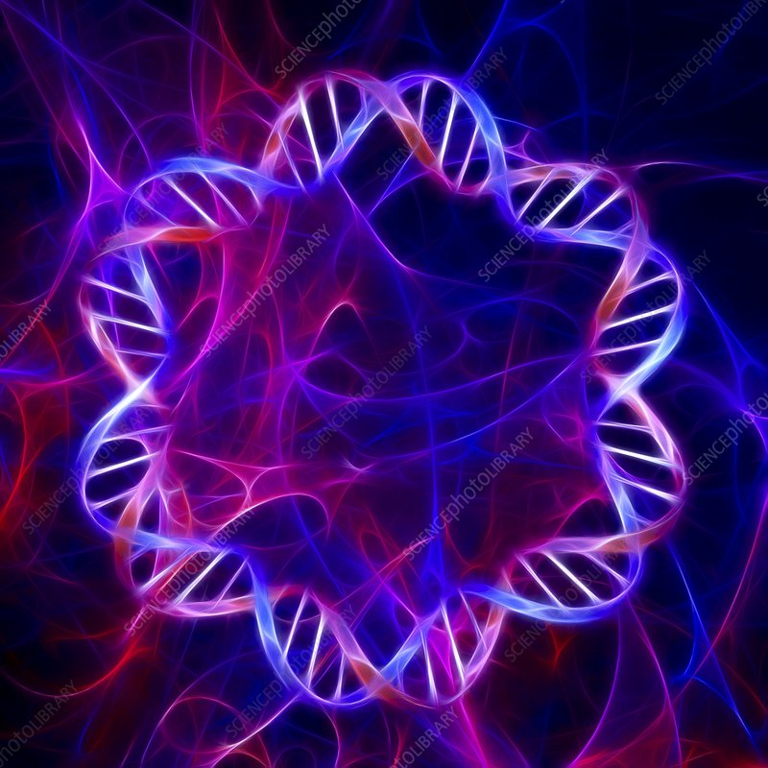
Hello everybody!
I’m Maria Chiara Biondini, PhD candidate in Sustainable Development and Climate Change (IUSS Pavia/University of Camerino)
My research topic: Biomolecules and Biomaterials for ecosystem protection and human health
Antarctic bacteria: powerful green sources for molecules of biological and biotechnological interest…
…With a unique evolutionary history!
Little skills with MEGA but... I want to improve my knowledge!

